Slide 1
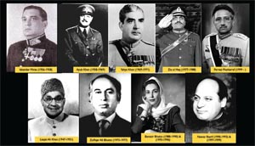
PAKISTAN HISTORICAL TRAJECTORY
WEEK
02
Ayyub Era 1958-1969
Introduction of Basic Democracy & Second Constitution 1962
The Decade of Economic Development
CLO 02
Students will be able to analyze Pakistan’s political and constitutional evolution from 1958 to the present, including civil- military relations, democratic transitions, and governance challenges. Also, able to critically evaluate governance reforms, constitutional amendments, economic initiatives (e.g., CPEC), and their impact on political stability and national development.

Slide 2
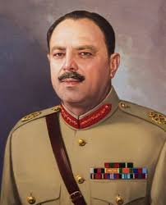
Pakistan’s Historical Trajectory (1958–1971)
The period from 1958 to 1971 represents one of the most transformative yet turbulent phases in Pakistan’s political history. It began with the first military coup by General Ayub Khan, which ended parliamentary democracy and introduced authoritarian modernization.
This era witnessed economic growth, institutional restructuring, and constitutional engineering under the Basic Democracies system and the 1962 Constitution. However, it also produced political alienation, regional disparities, and democratic suppression.
The transition to General Yahya Khan’s rule intensified instability, leading to Pakistan’s first general elections and ultimately the tragic dismemberment of the country in 1971. This period reshaped Pakistan’s political culture permanently.
General Ayub Khan

Slide 3
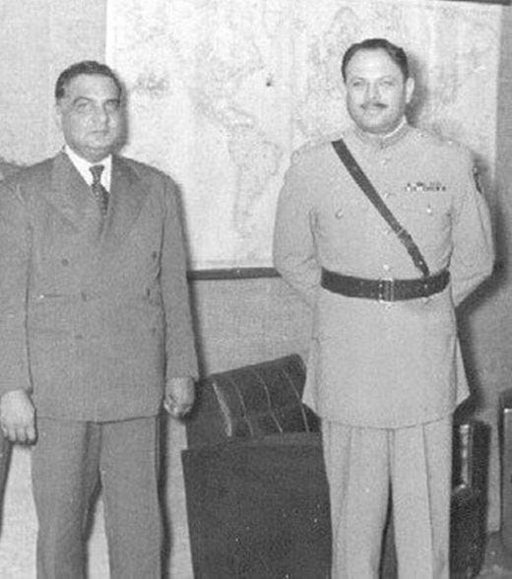
Background to Ayub Khan’s Coup (1958)
Pakistan’s early years were marked by constitutional instability, frequent government changes, and weak political institutions. Political infighting among elites, corruption, and administrative inefficiency weakened democratic governance. Between 1947 and 1958, several prime ministers were dismissed before completing terms, creating chaos. Bureaucracy and military gradually gained influence.
President Iskander Mirza imposed martial law in October 1958 in collaboration with Army Chief Ayub Khan. Soon after, Ayub removed Mirza and assumed full authority, marking Pakistan’s first direct military takeover and the end of parliamentary democracy.

Slide 4
Ayub Khan’s Governance Philosophy
Ayub Khan believed Pakistan required strong centralized leadership rather than parliamentary politics. He argued that Western democracy was unsuitable for Pakistan’s social structure.
His governance focused on discipline, modernization, and technocratic planning. Political opposition was suppressed, civil liberties were restricted, and press freedom was limited.
At the same time, he emphasized economic reforms, administrative efficiency, and national development.
Ayub presented himself as a modern reformer who could stabilize the country. However, his authoritarian style created resentment among political parties, students, and intellectuals who demanded democratic restoration.

Slide 5
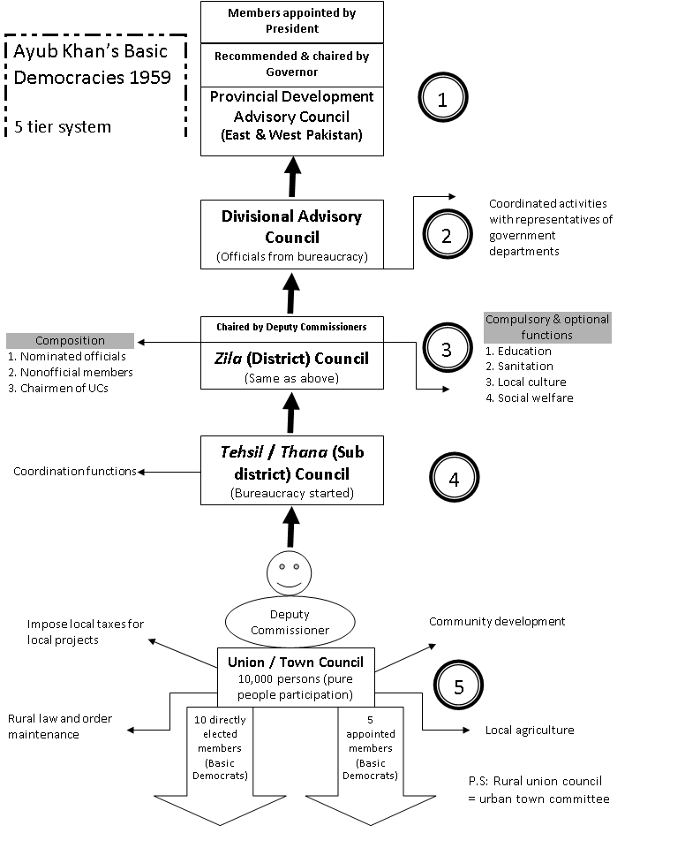
Basic Democracies System (1959)
The Basic Democracies system introduced in 1959 aimed to restructure local governance through elected councils at village and urban levels. Approximately 80,000 Basic Democrats were elected to manage local development and administrative issues. However, the system’s real purpose was political control. These representatives formed the electoral college for presidential elections and constitutional referendums. Political parties were excluded, and mass political participation was limited. Although some local development occurred, the system mainly strengthened Ayub Khan’s authority and weakened democratic institutions at the national level.

Slide 6
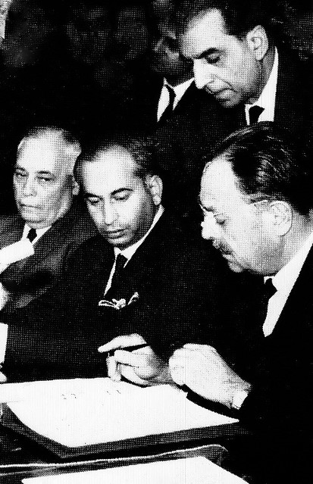
Political Impact of Basic Democracies
The Basic Democracies system transformed Pakistan’s political structure by replacing representative democracy with controlled participation. It reduced the role of political parties and limited citizen influence over national decision-making.
Ayub Khan used it to legitimize his presidency through indirect elections. While it created administrative decentralization on paper, power remained centralized.
The system encouraged patronage politics and loyalty to the regime rather than accountability to voters. Over time, people recognized its undemocratic nature, contributing to growing dissatisfaction and resistance against military rule.

Slide 7
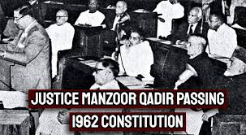
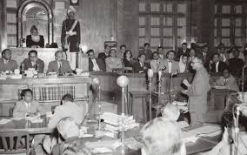
The Constitution of 1962 – Main Features
The 1962 Constitution established a presidential system with extensive executive powers. The president served as both head of state and government. The National Assembly was indirectly elected through Basic Democrats. Political parties were initially banned, weakening opposition.
The judiciary’s independence was limited, reducing checks on executive authority. Fundamental rights were suspended initially and later restored with restrictions. The constitution aimed to ensure stability and efficiency but sacrificed democratic representation. It provided legal cover for authoritarian governance while marginalizing public participation in politics.

Slide 8
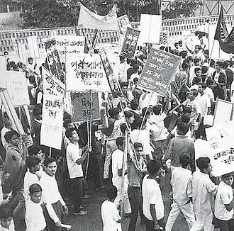
Effects on Democratic Development
The 1962 Constitution severely weakened democracy in Pakistan. Direct elections were removed, reducing public influence over leadership. Political repression increased, and accountability declined.
The concentration of power encouraged authoritarian tendencies. Although stability was claimed, political frustration grew across society. Students, workers, and opposition leaders criticized the regime’s undemocratic nature.
The constitution failed to reflect diverse regional demands and political aspirations. This structural imbalance fueled unrest that eventually undermined Ayub Khan’s rule and contributed to long-term political instability.

Slide 9
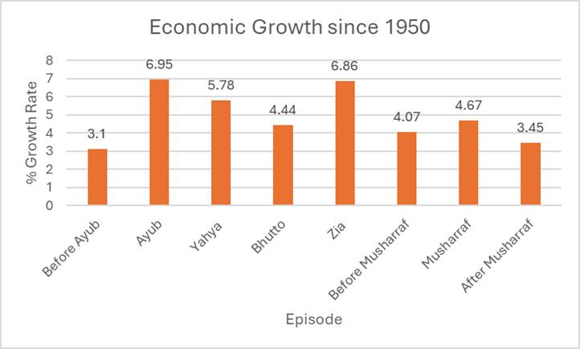
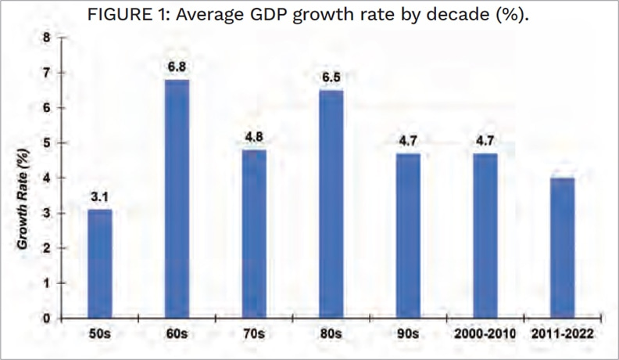
The Decade of Development – Economic Strategy
The 1960s were labeled the Decade of Development due to rapid economic growth under Ayub Khan.
The government emphasized industrialization, infrastructure development, and agricultural modernization.
Five-Year Plans encouraged private investment and export industries.
Major projects included dams, highways, and irrigation networks.
Pakistan achieved high GDP growth rates and gained international recognition as a developing economy model.
However, economic benefits were unevenly distributed, favoring urban elites and industrialists while neglecting rural populations and poorer regions.

Slide 10
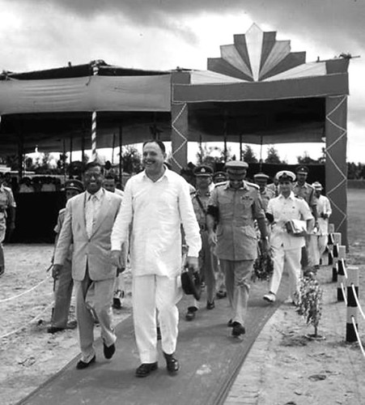
Industrial Expansion and Wealth Concentration
Industrial growth led to the rise of powerful business families controlling major sectors such as textiles, cement, and banking. Government policies provided loans, tax incentives, and protection to large enterprises. While industrial output increased significantly, wealth became concentrated among a small elite commonly known as the ‘22 families.’
This inequality created social tension and resentment among workers and lower-income groups. Small industries struggled to compete. The perception that development benefited only the rich weakened public trust in the government’s economic policies.

Slide 11

Agricultural Reforms and Rural Outcomes
Ayub Khan introduced land reforms to limit large estates and redistribute land to farmers. Mechanization, better seeds, and irrigation expanded agricultural production. Crop yields improved, especially wheat and rice.
However, powerful landlords avoided reform through legal loopholes and retained most of their land. Small farmers received limited benefits and remained economically vulnerable.
Although productivity increased, social justice goals were largely unmet. Rural inequality persisted, reinforcing traditional power structures and limiting genuine agrarian transformation.

Slide 12
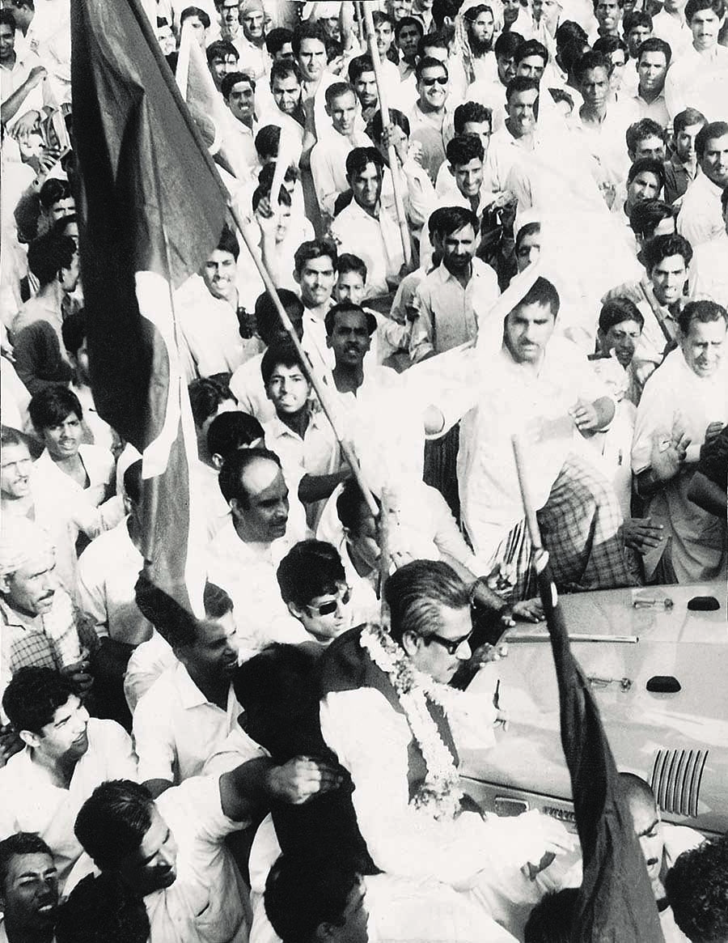
Regional Economic Disparities
Economic development heavily favored West Pakistan, particularly Punjab and Karachi. Most industrial investment, infrastructure, and defense spending were concentrated there.
East Pakistan, despite having a larger population, received fewer resources and development projects. Bengalis felt economically exploited as raw material suppliers without fair returns.
This imbalance intensified political frustration and strengthened demands for provincial autonomy.
Sheikh Mujibur Rahman’s Six Point Movement emerged largely as a response to economic injustice and political marginalization experienced by East Pakistan.

Slide 13
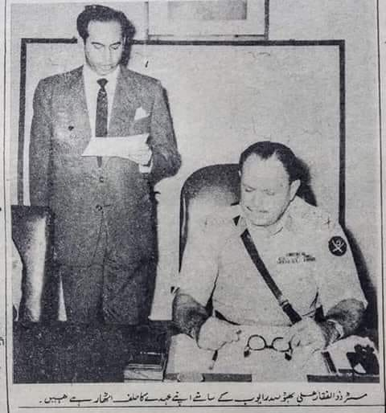
Opposition Movements Against Ayub Khan
By the late 1960s, widespread protests erupted across Pakistan.
Students demanded political freedom, workers opposed inequality, and politicians called for democracy.
The 1965 war with India damaged Ayub Khan’s image of strength. Rising inflation and unemployment increased public hardship.
Zulfikar Ali Bhutto mobilized mass support through socialist and populist slogans.
Strikes and demonstrations paralyzed major cities. Unable to control the unrest, Ayub Khan resigned in 1969, ending a decade of military-dominated rule.

Slide 14
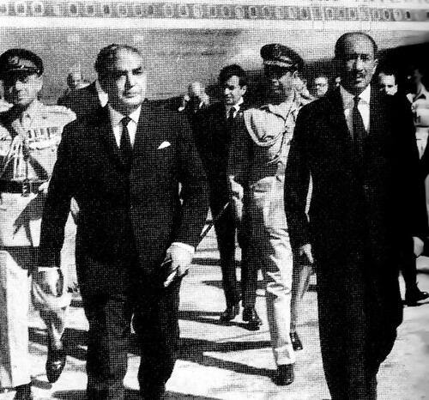
Yahya Khan’s Takeover (1969)
General Yahya Khan assumed power after Ayub’s resignation and imposed martial law.
He dissolved the 1962 Constitution and national assemblies, promising democratic restoration.
Yahya abolished the One Unit system to reduce regional resentment and restored provincial boundaries.
He announced general elections based on adult franchise, raising hopes for civilian rule.
However, political polarization intensified, particularly between East and West Pakistan.
The military remained deeply involved in political affairs, limiting genuine democratic transition.

Slide 15
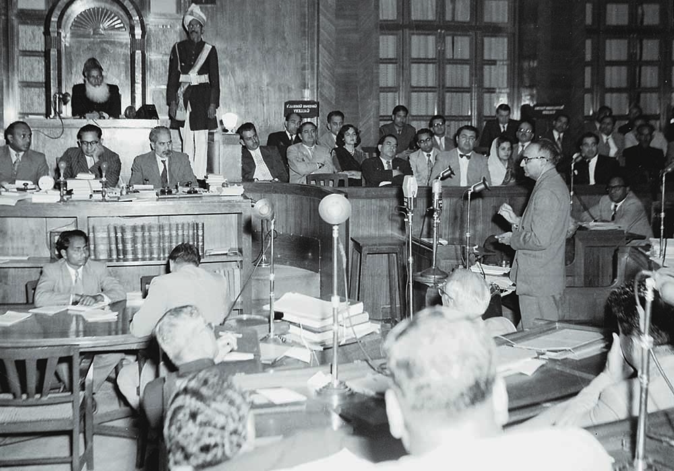
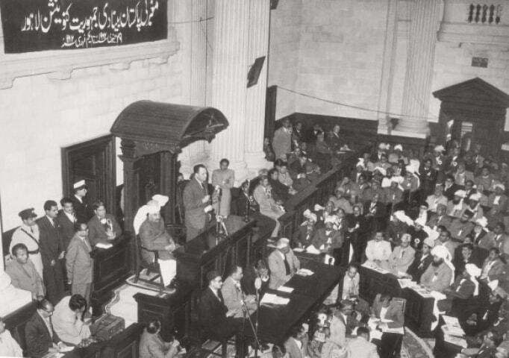
Legal Framework Order (1970)
The Legal Framework Order outlined procedures for Pakistan’s first general elections and constitution-making. I
t created a unicameral National Assembly tasked with drafting a new constitution.
However, it imposed conditions preserving Pakistan’s unity, Islamic identity, and strong central authority. These restrictions conflicted with East Pakistan’s demand for autonomy.
Although intended to guide democratic transition, the LFO created ambiguity and mistrust. It later contributed to political conflict when election results favored the Awami League overwhelmingly.

Slide 16
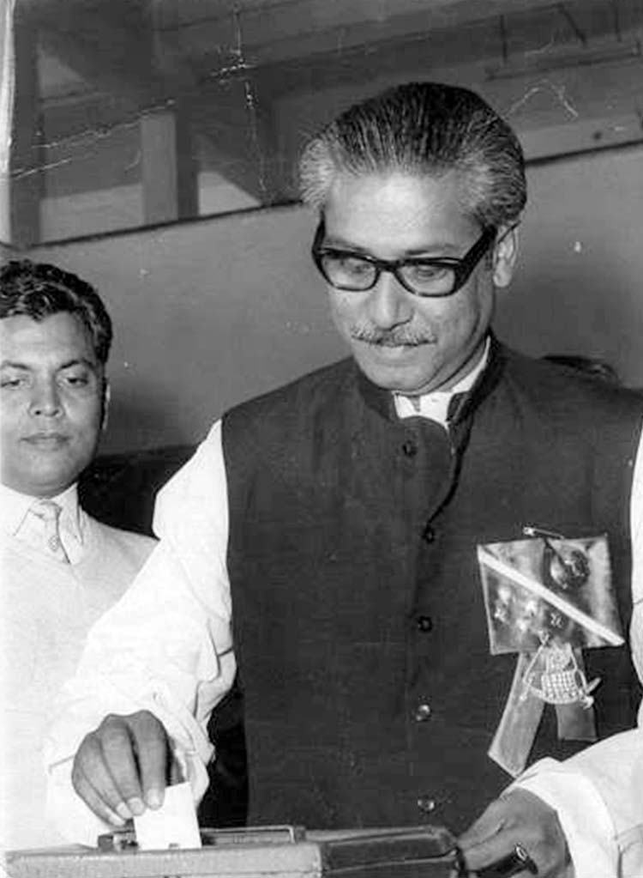
General Elections of 1970
The 1970 elections were Pakistan’s first nationwide democratic elections based on universal adult suffrage. Voter participation was high, reflecting public enthusiasm for democracy.
The Awami League won a majority in the National Assembly by sweeping East Pakistan.
The Pakistan People’s Party dominated West Pakistan.
The results clearly represented regional political preferences. Constitutionally, Sheikh Mujibur Rahman had the right to form government. However, political rivalry and military hesitation prevented peaceful power transfer.
Sheikh Mujeeb Ur Rehman (AL)

Slide 17
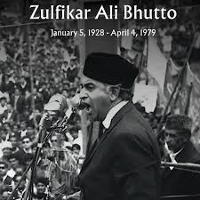
Post-Election Political Deadlock
After the elections, Bhutto refused to accept Awami League’s exclusive authority and demanded a power-sharing arrangement.
The military feared Mujib’s Six Point Program would weaken central control.
Negotiations among Yahya Khan, Mujib, and Bhutto repeatedly failed. The postponement of the National Assembly session triggered massive protests in East Pakistan.
Civil disobedience paralyzed administration. The deadlock revealed leadership failure and inability to respect democratic outcomes, pushing the country toward violent confrontation.

Slide 18
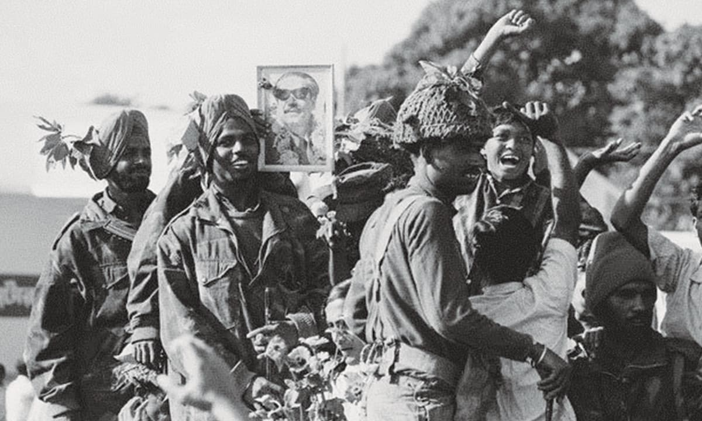
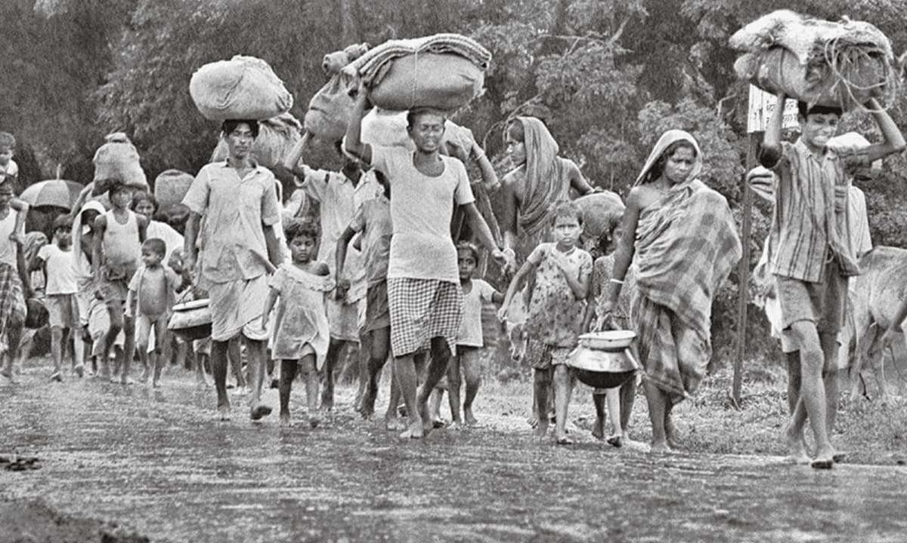
Military Operation in East Pakistan
In March 1971, the army launched Operation Searchlight to suppress Bengali resistance.
Universities, political leaders, and civilian neighborhoods were targeted. Thousands were killed, and widespread human rights abuses occurred.
Rather than restoring order, the operation intensified nationalist resistance. Millions of refugees fled to India, creating a humanitarian crisis.
The conflict evolved into a liberation war led by the Mukti Bahini. Military force replaced political dialogue, making separation increasingly inevitable.

Slide 19
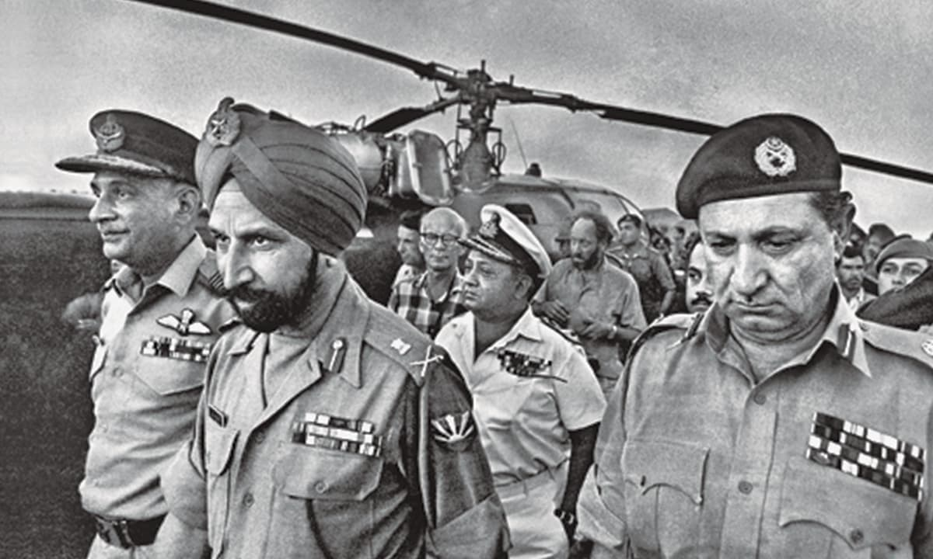
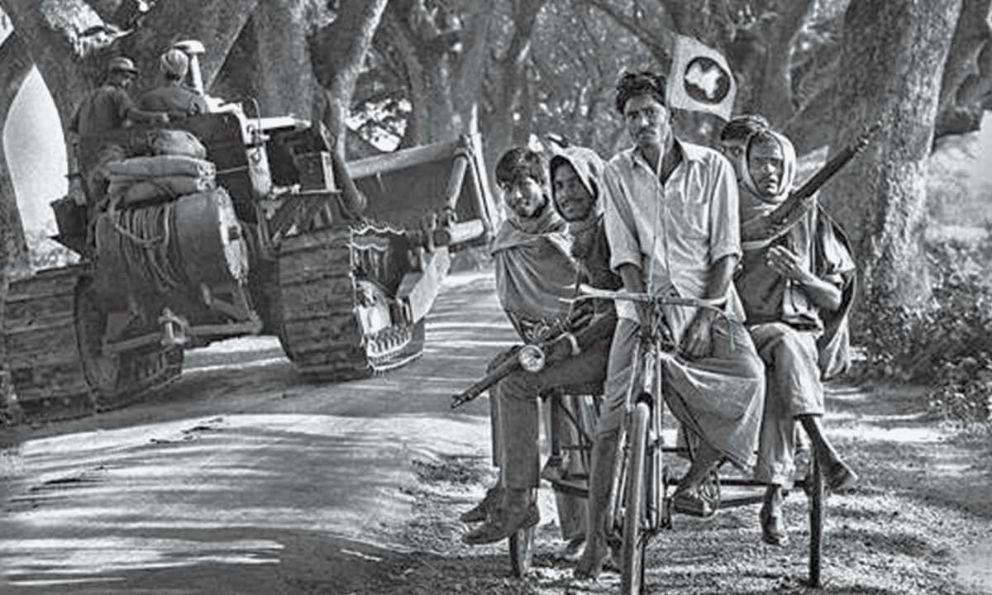
Fall of Dhaka – December 1971
India intervened militarily in December 1971, supporting Bengali forces. Pakistani troops in East Pakistan were isolated and outnumbered. After intense fighting, the army surrendered in Dhaka on December 16, 1971. Approximately 93,000 soldiers became prisoners of war. This marked the creation of Bangladesh as an independent state. It was Pakistan’s greatest military defeat and a severe blow to national unity, morale, and international reputation.

Slide 20
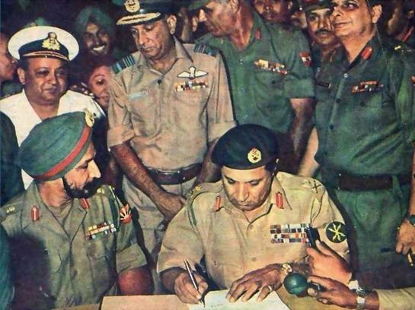
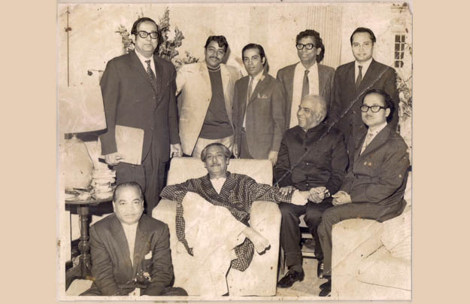
Causes of Pakistan’s Breakup
The disintegration of Pakistan resulted from long-term structural problems. Political authoritarianism suppressed democracy for decades. Economic inequalities created regional resentment. Failure to accommodate autonomy demands weakened national unity. Military dominance undermined civilian institutions. Refusal to honor election results destroyed constitutional legitimacy. Cultural and linguistic discrimination further alienated Bengalis. Combined, these factors made unity unsustainable. The 1971 crisis was not sudden but the outcome of persistent governance failures.

Slide 21
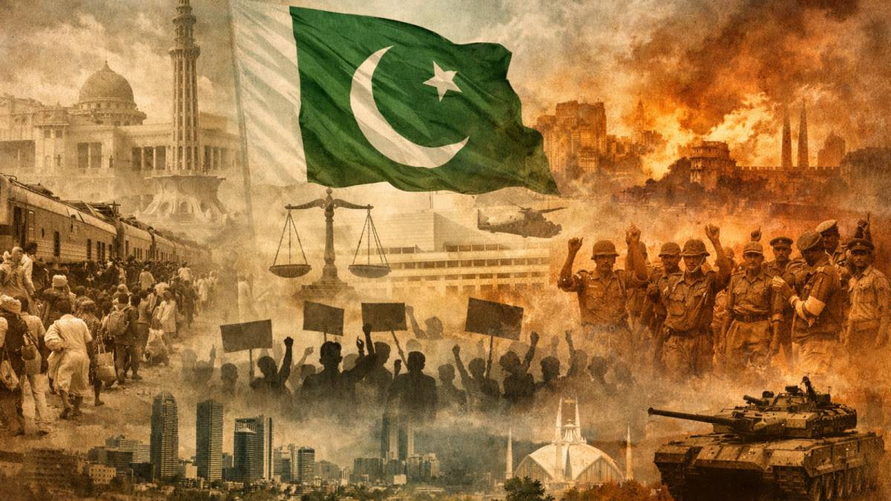
Conclusion and Historical Lessons
The era from Ayub Khan to Yahya Khan demonstrates the dangers of authoritarian rule, economic injustice, and political exclusion. Development without equity breeds instability. Suppressing democratic processes leads to alienation and conflict. Respect for electoral mandates and regional diversity is essential for national unity. Pakistan’s dismemberment remains a critical lesson in constitutionalism, civilian supremacy, and inclusive governance. Understanding this period helps students analyze contemporary political challenges and the importance of democracy in state stability.

